Slide 1
The Trucking Industries Reaction to COVID 19: What’s Happened and What to Expect
Presented by The Primerus Transportation Practice Group
Tab Keener
Downs & Stanford
Dallas, TX

Slide 2
Overview of What the Trucking Industry is Facing Now

Slide 3
FMCSA Emergency Declaration Provisions

Slide 4
What Does the Emergency Declaration Cover

Slide 5
What is NOT Covered Under the Emergency Declaration

Slide 6
Who Is Covered By The Emergency Waiver

Slide 7
What Must A Driver Carry To Document Operations Under A Waiver

Slide 8
What Can We Do vs.
What Should We Do

Slide 9
What Does It All Mean?

Slide 10
FMCSA Coronavirus Information and Resources
FMCSA Coronavirus (COVID-19) Information & Resources
Expanded Emergency Declaration Under 49 CFR § 390.23 No. 2020-002 (Relating to COVID-19)
Frequently Asked Questions Related to the FMCSA Emergency Declaration 03/19/2020
General Emergency FAQs
Statement on State and Local Shelter in Place and Other Restrictions on Movement Relating to COVID-19
  https://trucking.org/
  https://trucking.org/COVID19

Slide 11
Carriers Issuing Statements Regarding Travel Restrictions

Slide 12

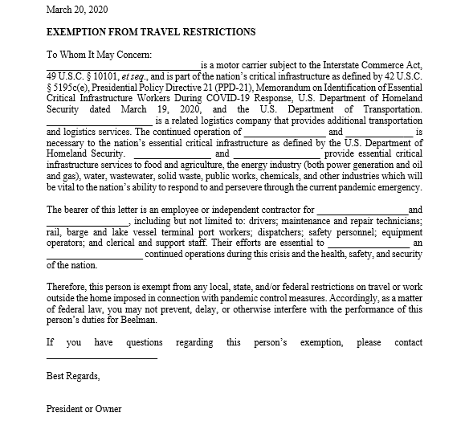

Slide 13
Problems Encountered

Slide 14
What Should Companies Be Doing?

Slide 15
Questions?

Slide 16

Thank You
Tab H. Keener
Shareholder
Downs & Stanford, P.C.
2001 Bryan Street, Suite 4000
Dallas, Texas 75201
E-mail tkeener@downsstanford.com
Phone (214) 397-1323 (direct)
Cell (214) 336-5006
Fax (214) 748-4530
www.downsstanford.com

